Slide 1
ESC101: Fundamentals of Computing
Introduction to Arrays
Nisheeth

Slide 2
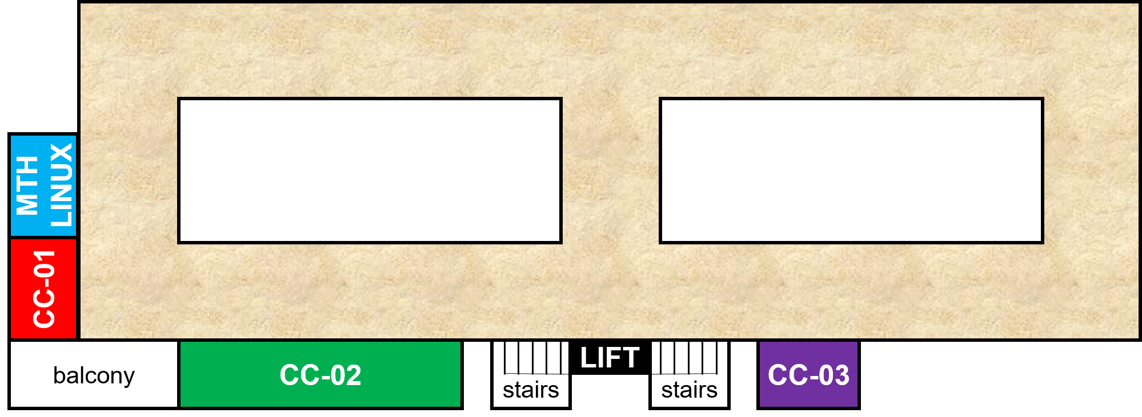
Mid-sem Lab Exam: February 15 (Saturday)
Morning exam
10:00 AM - 12:30 PM – starts 10:00 AM sharp
CC-01: A9, {A14 even roll numbers}
CC-02: A7, A10, A11
CC-03: A12
MATH-LINUX: A8, {A14 odd roll numbers}
Afternoon exam
12:45 PM – 3:15 PM – starts 12:45 PM sharp
CC-01: A1, {A2 even roll numbers}
CC-02: A4, A5, A6
CC-03: A3
MATH-LINUX: A13, {A2 odd roll numbers}

Slide 3
Mid-sem Lab Exam: February 15 (Saturday)
Go see your room during this week’s lab
Be there 15 minutes before your exam time
No entry for candidates arriving later than 09:45 for morning exam and 12:30 pm for the afternoon exam
Cannot switch to another session (morning to afternoon or vice-versa)
Syllabus – till functions (no arrays)
Open handwritten notes – However, NO printouts, photocopies, slides, websites, mobile phone or tablet
POSSESSING ANY OF THESE WILL BE CONSIDERED CHEATING
Prutor CodeBook will be unavailable during lab exam
Exam will be like labs - marks for passing test cases
Marks for writing clean indented code, proper variable names, a few comments – illegible code = poor marks

Slide 4
How to store lots of values of same type?
We have seen many data types so far
int, float, char, etc.
We can use a variable to store a single value of some data type, e.g.,
int x = 2; // variable x stores one integer value
float x = 2.3; // variable x stores a one float value
char x = ‘c’; // variable x stores one char value
What if we want to store several values, all of same data type?
Example 1: Marks of all ESC101 students in Major Quiz 1 (all floats)
Example 2: Roll numbers of all ESC101 students (all int)
Example 3: Final grade of all ESC101 students (all char)

Slide 5
How to store lots of values of same type?
Consider storing Major Quiz 1 marks of all ESC101 students
This is very time consuming, inelegant, and boring
Arrays provide a better and more efficient way of doing such things
float marks1, marks2, marks3, .... ,marks500;
scanf(“%f”, &marks1);
scanf(“%f”, &marks2);
...
scanf(“%f”, &marks500);

Slide 6
Arrays
Not a new data type but a “data structure” (a collection of variables)
Enables storing multiple values of the same data type
Specification/declaration of an array needs the following
A data type (data type of values to be stored; all must be of same type)
A name (same naming convention as variables)
A size (how many values to be stored)
An example of array declaration:
float marks[500];
Data type
Size is an integer in square brackets
Name
Size

Slide 7
Arrays: Basic Syntax
In some other languages (such as Python), array indexing starts with 1
Each value within the array is called “element” of the array
Each element is accessed using a non-negative integer-valued index
First index is 0 (index of first element)
Last index is array size minus one (index of last element)
Syntax to access/use each element of the array
name_of_array[index]
For example:
marks[0] is the first element of an array named marks
marks[1] is the second element of array marks
marks[499] is the last element of array marks
Index is an integer in square brackets

Slide 8
Arrays: Basic Syntax
Array index needs to be within limits (0 to array size - 1)
For an array declared as marks[500]
Index -1 is invalid (may give segmentation fault, also known as “segfault”)
Index 510 is invalid (may give segfault)
Index 500 is also invalid (recall that 499 is the index of last element)
Array index need not be a constant integer,
Can also be a variable/expression (but only int)
Example: marks[i] or marks[2*i + 1] where i is an integer
Never use a float/double as index

Slide 9
Arrays: Storage in memory
Array name is like street name, index is like house number
A single variable (int/float/char etc) is stored in a single box in memory
An array is stored in several consecutive boxes in memory (number of these boxes is equal to the size of the array)
More on storage of arrays when we study Pointers
int a = 2;
float b = 3.2;
2
3.2
a
b
float marks[500];
marks[0]
marks[1]
marks[2]
marks[499]

Slide 10
Array: Declaration and Initialization
Array elements are comma separated
Can be initialized at time of declaration itself
Can be partly initialized as well
However, if not initialized in same line with declaration, have to be initialized one by one!
int a[6] = {3,7,6,2,1,0};
a
3
7
6
2
1
0
int a[6] = {3,7,6};
a
3
7
6
int a[6];
a = {3,7,6,2,1,0};
int a[6];
a[2] = 6;

Slide 11
Array: Declaration and Initialization
Can be initialized at time of declaration itself
Can be partly initialized as well
Over initialization may crash
Better way to initialize is the following
Warning: uninitialized arrays contain garbage, not zeros
int a[6] = {3,7,6,2,1,0};
a
3
7
6
2
1
0
int a[6] = {3,7,6};
a
3
7
6
int a[6] = {1,2,3,4,5,6,7,8,9};
I will figure out how much space needed
No need to specify the array size during declaration
int a[] = {1,2,3,4,5,6,7,8,9};

Slide 12
Array: Traversal
#include <stdio.h>
int main() { int array[] = {1,2,3,4,5}; int i, n = 5; printf(" The array elements are: \n " ); for( i=0;i < n; i++) { printf(" array[%d] = %d \n " , i, array[i] ); }
return 0; }
Initialize
Output:
array[0] = 1
array[1] = 2
array[2] = 3
array[3] = 4
array[4] = 5
Access
* Pro-tip: Remember that first element has index 0, and nth element has index n-1

Slide 13
Next Class: More on arrays..
Other ways of initializing arrays
Example programs using arrays
Array functions

